Slide 1
A statistical comparison of human written and AI-generated code across programming languages
PROBABILITY AND STATISTICS SEMESTER PROJECT | REVIEW 2
A preliminary study of code length and comment characteristics.
By Akanksha Gupta (25BAI0033) and Bhargavi Panwar (25BDS0081) from SCOPE
Faculty Guide: Professor Juhi Baroi.

Slide 2
Review 1 Summary
Dataset
Total 10,000 code samples are present out of which 5,000 are hand written and 5,000 are AI generated
Languages used are C, C++, Java and Python.
Analysis Performed
Descriptive statistics
Welch's t-tests and 95% confidence intervals
Chi-square test
Initial visualisations
Key Findings
Human code had a higher mean line count: 29.59 vs 25.54
AI code had a higher mean character count: 678.63 vs 557.86
Both pooled comparisons were statistically significant, with small effect sizes.
Next Step: Compare Human and AI code separately for each programming language

Slide 3
Statistical Methods Used
1. Welch's t-test
Compares the average values of Human and AI code without assuming equal variances between the two groups.
2. 95% Confidence Interval (CI)
Provides a range of plausible values for the true difference between the group means.
3. Effect Size (Cohen's d)
Measures how large the difference between Human and AI code is, not just whether it is statistically significant.
4. Holm Correction
Adjusts p-values when multiple statistical tests are performed, helping control false positive results.
5. Wilcoxon Rank-Sum Test
A rank-based test used as a robustness check when comparing the distributions of Human and AI code measurements.

Slide 4
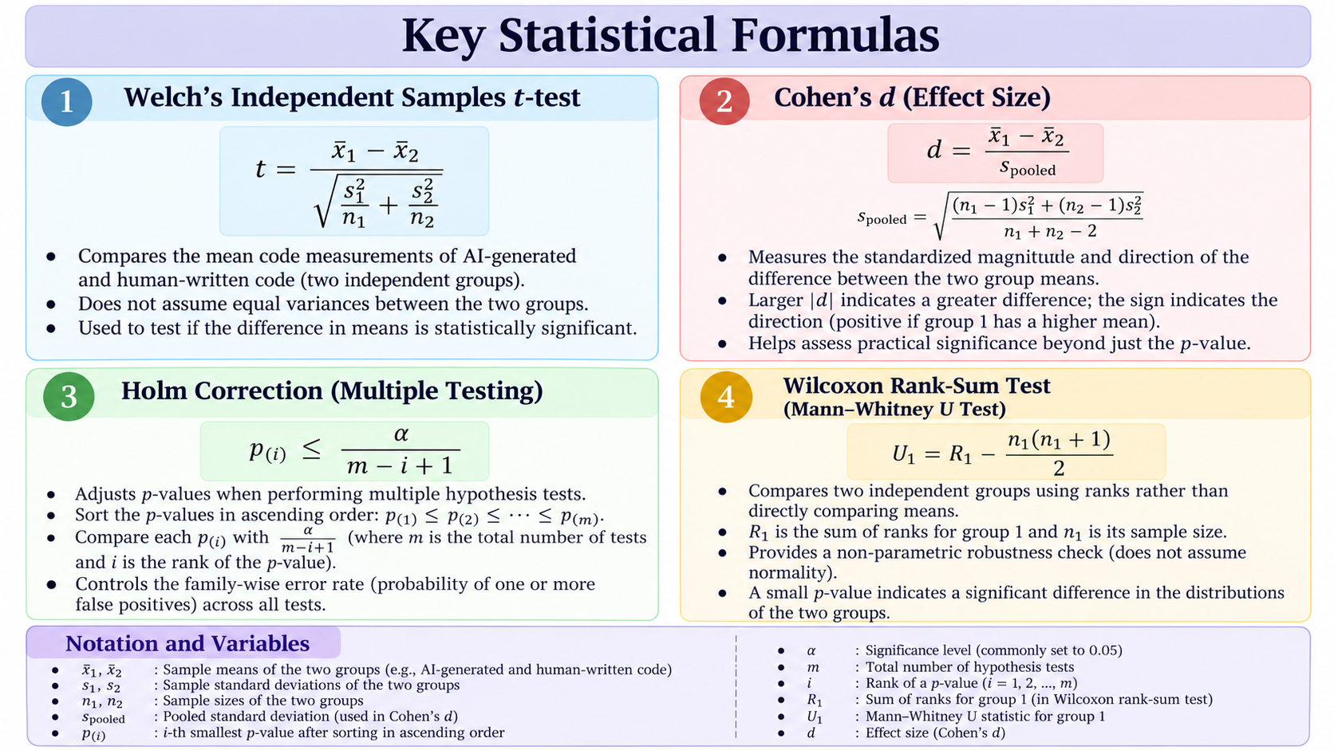

Slide 5
Language-wise Descriptive Analysis
Objective
Descriptive statistics were calculated separately for C, C++, Java, and Python to identify differences between human and AI generated codes.
Key observations
C: AI-generated code had higher mean line and character counts.
C++: Human-written code had a higher mean line count, while mean character counts were similar.
Java: AI-generated code had higher mean character counts, while human-written code had a higher mean line count.
Python: AI-generated code had higher mean character counts, while human-written code had a slightly higher mean line count.
Purpose: To identify language-specific patterns before interpreting the hypothesis tests.

Slide 6
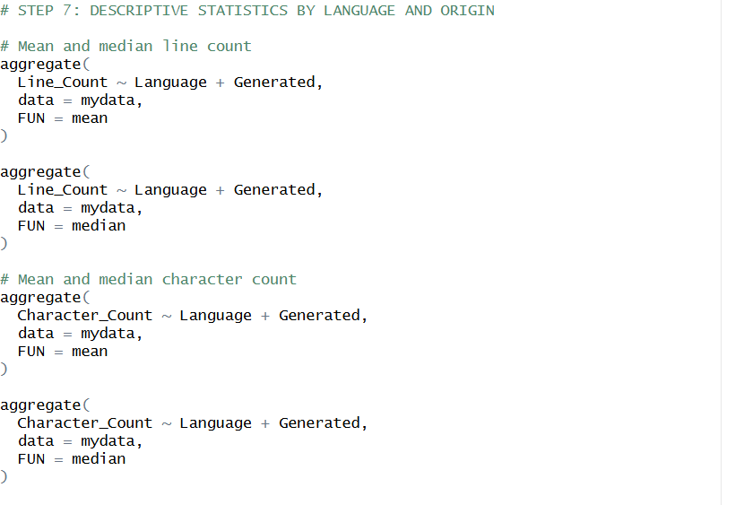
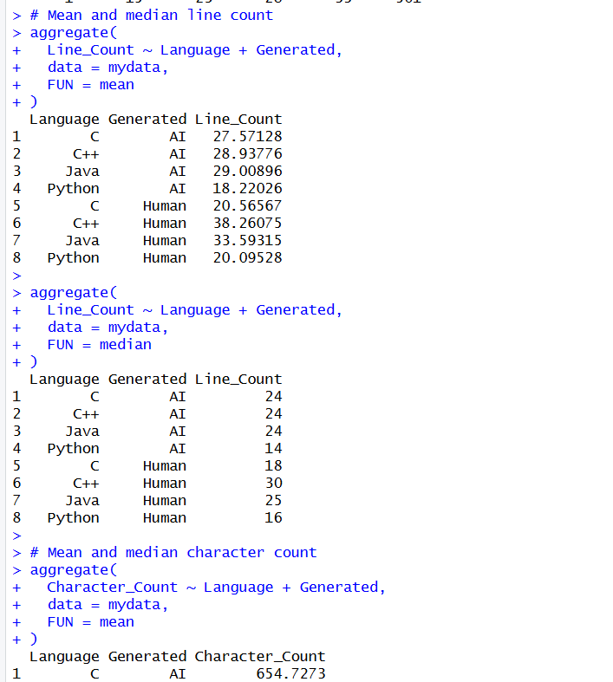
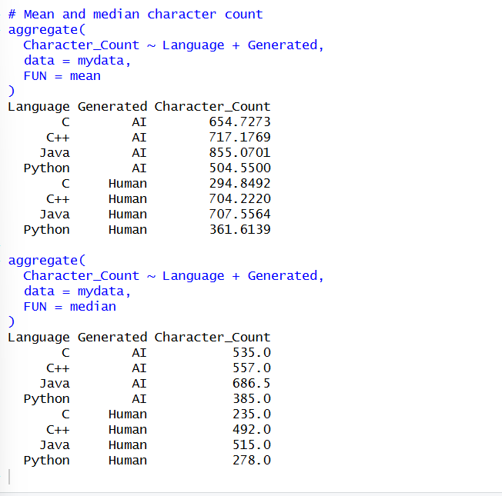
Language | Mean lines (AI / Human) | Mean characters (AI / Human)
C | 27.57 / 20.57 | 654.73 / 294.85
C++ | 28.94 / 38.26 | 717.18 / 704.22
Java | 29.01 / 33.59 | 855.07 / 707.56
Python | 18.22 / 20.10 | 504.55 / 361.61

Slide 7
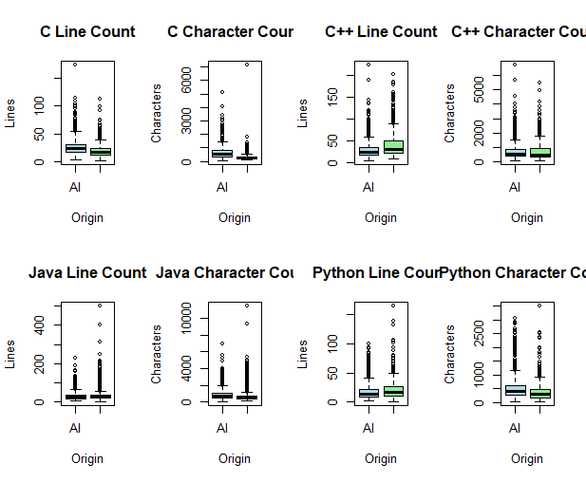
Graphs
“Boxplots compare the median, spread, and outliers of AI generated and human written code across four programming languages.

Slide 8
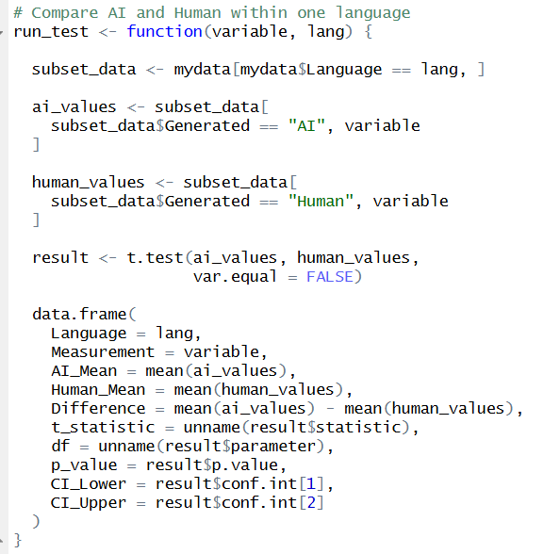
Welch’s T test result
Welch's t-test was used to compare the mean code length of AI generated and human written samples within each programming language.
Hypotheses
H₀: The mean code length is equal for AI generated and human written samples.
H₁: The mean code length differs between the two groups.
Key findings from the preliminary analysis
C: Significant differences in both line count and character count.
C++: Significant difference in line count, but not in character count after Holm correction.
Java: Significant differences in both measurements.
Python: Significant differences in both measurements.
Statistical criteria: 5% significance level, 95% confidence intervals, and Holm correction for eight comparisons.

Slide 9
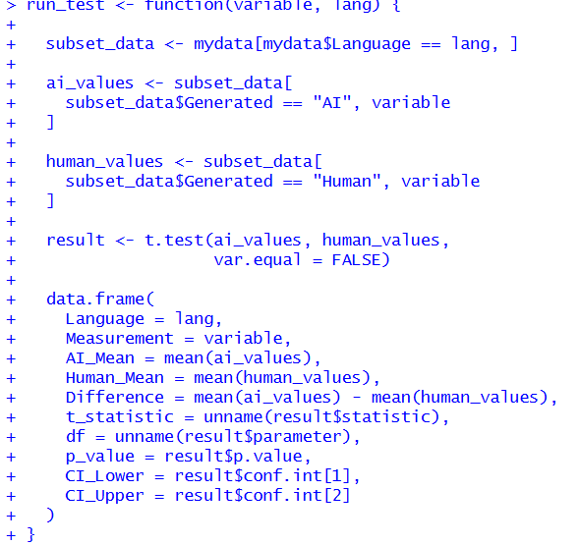
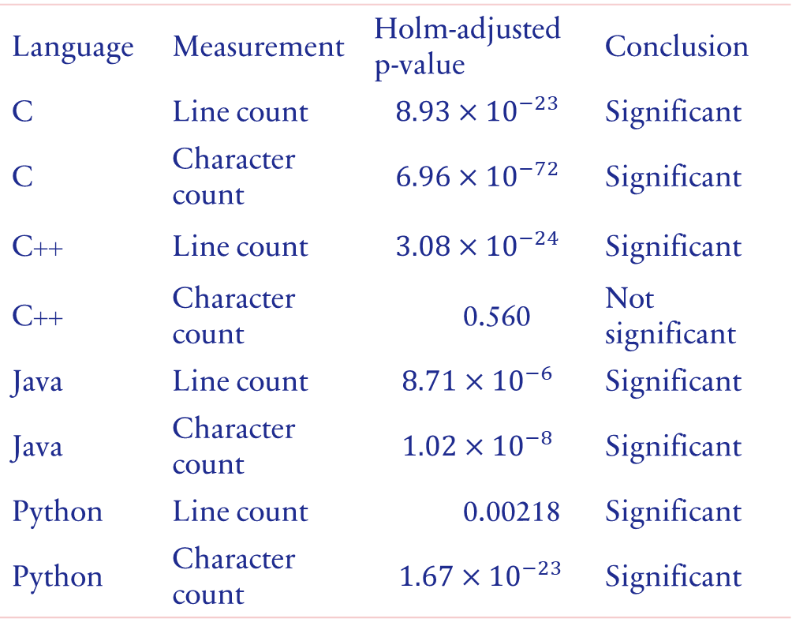
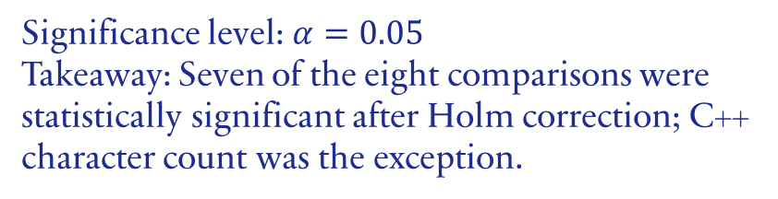
Language | Measurement | Holm-adjusted p-value | Conclusion
C | Line count | $$8.93×{10}^{−23}$$ | Significant
C | Character count | $$6.96×{10}^{−72}$$ | Significant
C++ | Line count | $$3.08×{10}^{−24}$$ | Significant
C++ | Character count | 0.560 | Not significant
Java | Line count | $$8.71×{10}^{−6}$$ | Significant
Java | Character count | $$1.02×{10}^{−8}$$ | Significant
Python | Line count | 0.00218 | Significant
Python | Character count | $$1.67×{10}^{−23}$$ | Significant
Significance level: $α=0.05$
Takeaway: Seven of the eight comparisons were statistically significant after Holm correction; C++ character count was the exception.
“Welch's t-tests compare group means; Holm correction controls the family-wise error rate across eight comparisons.”

Slide 10
Effective size analysis
Cohen's d was used to estimate the magnitude of the differences between AI-generated and human-written code.
Key findings from the preliminary analysis:
C: Large effect for character count ((≈0.87)); small-to-moderate effect for line count ((≈0.47)).
C++: Small-to-moderate effect for line count ((≈-0.40)); negligible effect for character count ((≈ 0.02)).
Java: Small effects for both measurements.
Python: Small-to-moderate effect for character count ((≈0.39)); small effect for line count.
Interpretation: Statistical significance does not necessarily imply a large or practically important difference.

Slide 11
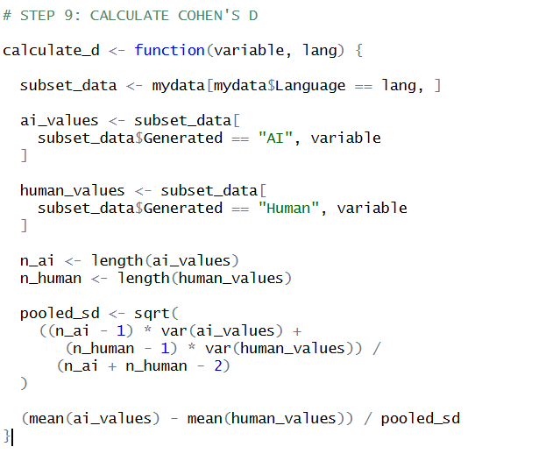
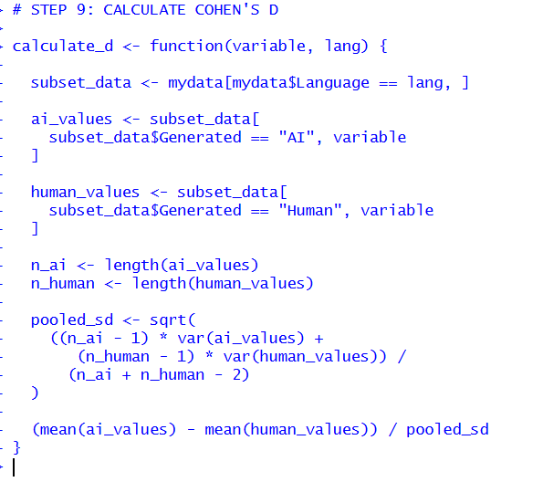

Slide 12
ROBUSTNESS CHECK: WILCOXON TEST
The Wilcoxon rank-sum test was used as a non parametric comparison of AI-generated and human-written code.
It compares the distributions using ranks rather than relying on the same assumptions as a t-test.
Its results provide a robustness check alongside Welch's t-test.
Differences should be interpreted using adjusted p values where multiple comparisons are performed.
Conclusion: Comparing both tests helps assess whether the observed differences are sensitive to the choice of statistical method.

Slide 13
Metric | AI-generated | Human-written
Mean comment count | 1.1184 | 0.6092
Median comment count | 0 | 0
Wilcoxon rank-sum test: (p < 2.2 × 10⁻¹⁶)
AI-generated code had a higher mean comment value than human-written code. However, more comments do not necessarily indicate better documentation.
2. Limitations
Approximate counting: The method may misclassify comment markers or miss some comments.
Sample independence: Only three problem IDs contained both Human and AI samples; repeated IDs may introduce dependence.
Measurement validation: Line and comment counts require further validation.
Interpretation: Code length and comment count alone cannot establish code quality or correctness.
Conclusion: The results indicate differences in counted comments, but should be interpreted cautiously due to measurement and dataset limitations.

Slide 14
OVERALL FINDINGS & FUTURE WORK
Key Findings
Differences in code length varied across C, C++, Java, and Python.
AI-generated code generally had higher mean character counts in the preliminary analysis.
Seven of eight Welch's t-test comparisons were statistically significant after Holm correction.
Comment-count analysis showed a higher mean for AI-generated code.
Limitations
Code length and comment count do not directly measure code quality.
Repeated problem IDs may affect the independence assumption.
Code-count measurements require validation.
Future Work
Validate line and comment-count calculations.
Investigate the effect of programming language and code origin together.
Extend the analysis and finalize conclusions using validated measurements.

Slide 15
Thank you

